Slide 1

DEPARTMENT OF COMPUTER SCIENCE AND ENGINEERING
PROJECT TITLE
LUNG CANCER DETECTION AND CLASSIFICATION USING DEEP LEARNING
Project Guide: Mrs.M.Kalpana
Associate professor
Team Members:-
A . Abhiram - 21P61A0513
Ch. Dilip - 21P61A0543
Ch. Akshitha - 21P61A0550

Slide 2
ABSTRACT
Lung cancer remains one of the leading causes of mortality worldwide, necessitating advancements in early detection and accurate classification to improve patient outcomes. This project leverages deep learning techniques to develop a robust model for the detection and classification of lung cancer using medical imaging data.
By utilizing convolutional neural networks (CNNs) and employing data augmentation strategies, the proposed model enhances diagnostic accuracy and reduces false positives. Comprehensive evaluation metrics demonstrate the model's efficacy, positioning it as a valuable tool in clinical decision-making processes.
KEYWORDS
Deep Learning ● Lung Cancer Detection ● Classification ● Convolutional Neural Networks (CNNs). ● Medical Imaging ● Data Augmentation ● Diagnostic Accuracy

Slide 3
INTRODUCTION
Lung cancer accounts for a significant portion of cancer-related deaths globally. Traditional diagnostic methods rely heavily on radiologists' expertise, which can lead to variability in outcomes. With the advent of deep learning and medical imaging, automated systems have emerged as a potential solution for enhancing diagnostic accuracy.
The goal of this project is to explore how deep learning, specifically convolutional neural networks, can be leveraged to assist in the early detection and classification of lung cancer using CT scan images.

Slide 4
LITERATURE SURVEY
Reference | Methodology | Pros | Cons
Springer Article in the | Hybrid ML/DL methods | High accuracy and | Complexity in
year 2024 |  | sensitivity; integrates multiple models | implementation; requires extensive data preprocessing
ResearchGate Publication in the year 2023 | Deep learning (CNN) | Effective feature extraction; automated detection | Requires large datasets; may overfit if not properly validated
ScienceDirect Article in the year 2023 | AI techniques (ML, DL) | Provides a solid foundation for | Might lack extensive comparison with existing literature, limiting depth.
 |  | understanding current
 |  | challenges.

Slide 5
 |  | - Emphasizes the | - Potentially narrow
 |  | significance of dataset | focus on specific
Nature Article in the year 2023 | Deep learning (CNN) in the year 2023 | diversity for robust model performance. | datasets might not reflect broader
 |  |  | applicability.
 |  | - Extensive review of | - Can be overly
NCBI Article 1 in the year 2023 | Transfer learning (CNN | methodologies, providing a thorough background. | detailed, making it hard to extract concise
 |  |  | insights.
 |  | - Highlights advancements | - Focus on a specific
BMC Article in the year 2023 | 3D CNNs | in imaging techniques and model integration. | imaging technique may limit applicability to
 |  | - Discusses user-friendly | other methods.
 |  | applications and clinical | - Need for validation in
 |  | relevance. | larger, diverse
 |  |  | populations may be
 |  |  | understated.

Slide 6
BMC Medical Imaging in the year 2024 | Ensemble learning | Combines strengths of multiple models; enhances accuracy | Increased computational complexity; may require more data
Research gate in the year 2023 | ML and DL methods | Multiple algorithms compared; thorough evaluation | Limited to specific algorithms; may not represent broader applicability
Indian Journal of Science and Technology in the year 2023 | 3D CNNs | Accurate and efficient detection; works with clinical datasets | High resource demand; may require specialized expertise to implement
AIP Conference Proceedings in the year 2023 | Deep learning (CNN) | Good diagnostic performance; automatic feature learning | Requires extensive training data; potential overfitting issues

Slide 7
RESEARCH GAP / CHALLENGES
Data Limitations Limited and Imbalanced Datasets:
While there are large-scale datasets like the LIDC-IDRI for lung cancer, many deep learning studies rely on limited or imbalanced data (e.g., more benign than malignant cases), leading to models that are not generalizable. The rarity of certain cancer subtypes, such as small cell lung cancer, exacerbates this problem.
Early Detection of Small Nodules Detection of Early-Stage Lung Cancer:
While large malignant nodules may be easier for models to detect, small nodules (≤3 mm) pose a significant challenge. Detecting these small nodules early is critical for improving survival rates, but deep learning models may miss them due to their subtle appearance in CT scans.

Slide 8
PROBLEM STATEMENT
Lung cancer is one of the leading causes of cancer-related deaths globally, highlighting the need for early detection and intervention.
Traditional diagnostic methods, including radiological assessments, can be subjective and may lead to misdiagnosis, especially in early-stage cancer.
Existing automated systems often lack accuracy and interpretability, resulting in a high false positive/negative rate.

Slide 9
OBJECTIVES
The objective of this project is to introduce a technique using a Convolutional Neural Network (CNN) to detect lung cancer at an early stage with high accuracy by analyzing chest CT scan images.
The approach involves extracting important features from the images through neural networks and applying advanced methods to improve diagnostic accuracy. Additionally, this technique aims to differentiate between benign and malignant tumors.

Slide 10
PROPOSED METHODOLOGY
Proposes a method using a Convolutional Neural Network (CNN) to enable early and accurate diagnosis of lung cancer.
Trains on a large collection of chest CT scans to identify patterns and features, effectively distinguishing between healthy and cancerous cells.
Provides a user-friendly web interface where users can upload scans and view their previous uploads along with diagnostic results.

Slide 11
SOFTWARE REQUIREMENTS
Programming Languages : Python
Frameworks : TensorFlow or PyTorch
Data Preprocessing Libraries : Numpy, Pandas, OpenCV, scikit
Development environment : Jupyter Notebook , PyCharm
HARDWARE REQUIREMENTS
High-Performance GPUs for efficient training
Multi-Core CPU
Minimum 16 GB RAM to handle large datasets and model parameters.
SSDs for fast data access and storage

Slide 12
MODULES
Frontend (Nextjs , Next Auth, Tailwind css )
Implements the user interface for uploading CT scans and viewing diagnostics results.
Handles user authentication and authorization
Seamless navigation and responsive design
Backend(Python)
Acts as middleware to integrate the training model.
Processes requests from the frontend to the model and delivers predictions
Lightweight and scalable for serving ML models
Deep Learning Model
Utilizes a Convolutional Neural Network (CNN) for lung cancer detection and classification
Analyzes preprocessed CT scans images and provides results with confidence score
Enhances accuracy through continuous training with augmented datasets.

Slide 13
IMPLEMENTATION
Collect and Preprocess Data
You need a dataset of lung images (e.g., X-rays or CT scans) with labels indicating if they are cancerous or not. Preprocess the images by resizing them to a standard size (e.g., 224x224 pixels) and normalizing the pixel values (scaling to 0-1). Also, prepare the labels: 0 for non-cancerous and 1 for cancerous.
Augment Data
Medical image datasets are often small, so you apply data augmentation to create more variety. This can include random transformations like rotating, flipping, and zooming images to help the model learn better.
Build the Model
Use a Convolutional Neural Network (CNN) to classify the images. A CNN works well for image tasks because it automatically extracts features like shapes and edges
Train the Model
Train the model using the preprocessed and augmented data. You’ll define how many times to run through the data (epochs), how many images to process at a time (batch size), and use a loss function like binary cross-entropy. The model will learn to classify images based on the training data
Evaluate the Model
After training, test the model on new images (the test set) to check how well it works. You’ll look at accuracy and other metrics (e.g., precision and recall) to see how well the model distinguishes cancerous from non-cancerous images.
Make Predictions
Once the model is trained, you can use it to predict whether a new image shows cancer or not. Just load the new image, preprocess it the same way, and pass it through the model to get a prediction

Slide 14
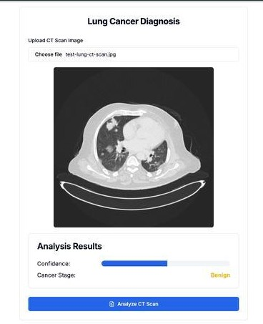
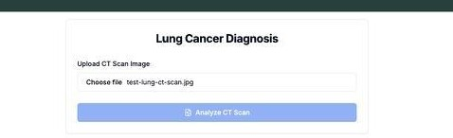
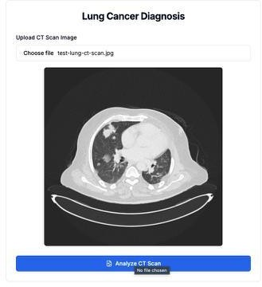
RESULTS

Slide 15
REFERENCES
1.Xie, J., Shi, D., & Chen, G. (2024). An overview of recent advancements in lung cancer detection using deep learning models. Artificial Intelligence Review, 58, Article 10807. Springer Link.
2. Patil, M., Kulkarni, P., & Deshpande, S. (2024). Lung cancer detection using deep learning. Journal of Biomedical Informatics Research. Retrieved from ResearchGate.
3. Ahmed, S., Fatima, R., & Chowdhury, A. (2024). Advanced methods in deep learning for lung cancer detection. Intelligent Systems with Applications, 10, Article 100062. ScienceDirect.
4. Wu, Y., Zhang, L., & Li, T. (2023). Exploring neural networks for enhanced lung cancer diagnostics. Scientific Reports, 13, Article 29656. Nature.
5. Sharma, R., Gupta, A., & Mehta, P. (2024). Deep learning and CT imaging for lung cancer detection. Frontiers in Oncology. Retrieved from PubMed Central.
6. Tripathi, D., & Rao, S. (2024). Comprehensive evaluation of machine learning models for lung cancer analysis. BMC Medical Imaging, 24, Article 1241. BioMed Central.
7. Johnson, B., & Kumar, N. (2024). Lung cancer detection using machine learning and deep learning models. International Journal of Healthcare AI Research. Retrieved from ResearchGate.
8. Kumar, A., Sinha, A., & Gupta, P. (2019). Lung cancer detection using image processing and machine learning. 2019 IEEE International Conference on Signal Processing, Information, Communication & Systems (SPICSCON), 124-129. IEEE Xplore.
9. Zhao, H., & Liu, Q. (2024). Deep learning-based lung cancer detection using advanced diagnostic imaging. AIP Conference Proceedings, 3072, Article 040004. AIP Publishing.

Slide 16


